Slide 1
INTRODUCTION TO SECURITY IN COMPUTING
Lecture 1: Introduction

Slide 2
Objectives for Chapter 1
Define computer security as well as basic computer security terms
Introduce the C-I-A Triad
Introduce basic access control terminology
Explain basic threats, vulnerabilities, and attacks

Slide 3
What Is Computer Security?
The protection of the assets of a computer system
Hardware
Software
Data

Slide 4
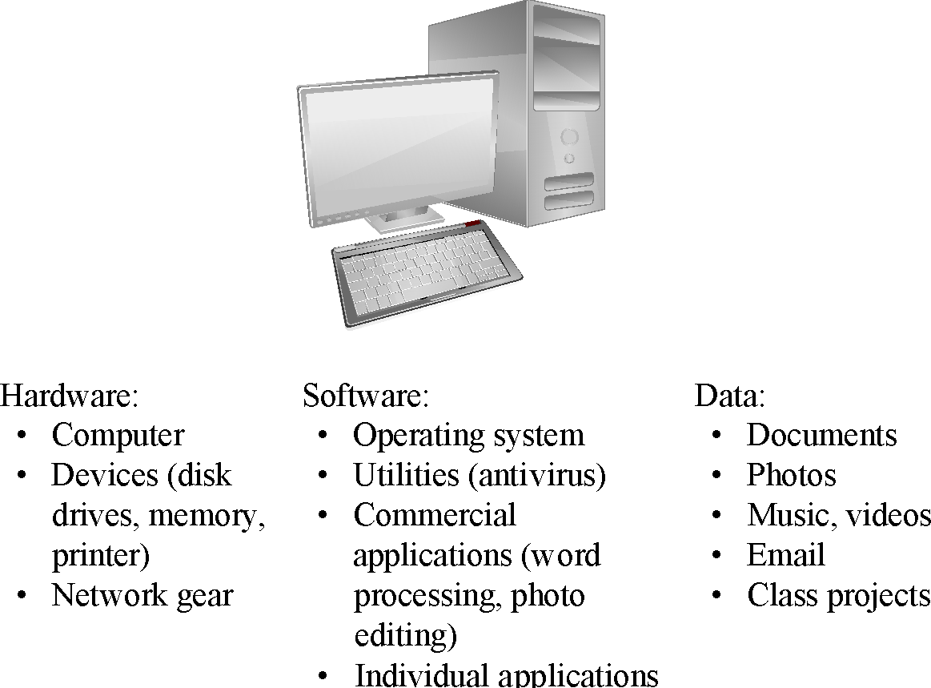
Assets

Slide 5
Value of assets
After identifying the assets to protect, we next determine their value.
All assets are not of the same value. What is valuable to you may not be as valuable to another software.
For example, in a notes taking application, personal notes are very important and can not be allowed to leak at any cost.

Slide 6
Value of assets
On the other hand, for a public pastebin, individual notes are not as valuable.
Identifying value is necessary because it helps us determine what type of security measures to take for which assets and which assets to put more emphasis on.

Slide 7
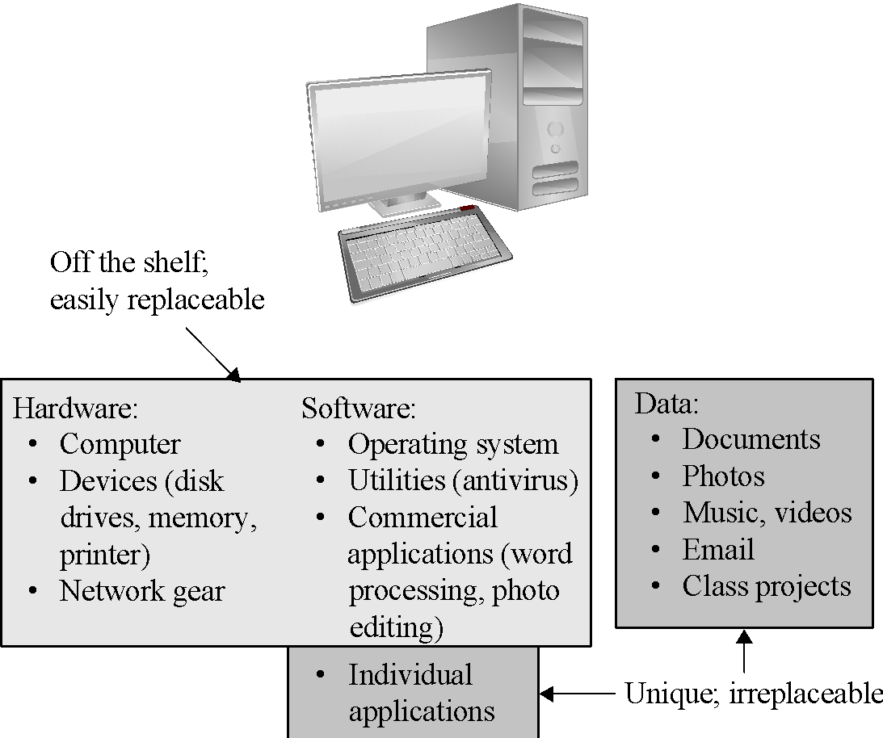
Values of Assets
Notes:
While hardware and software may be expensive, unique data cannot be replaced if it is lost.

Slide 8
Basic Terms
Vulnerability
Threat
Attack
Countermeasure or control
Notes:
There will be further discussion of each later in the chapter.

Slide 9
Vulnerabilities, Threats, Attacks, Controls
Vulnerability is a weakness in the security system
(i.e., in procedures, design, or implementation), that might be exploited to cause loss or harm.
Threat to a computing system is a set of circumstances that has the potential to cause loss or harm.
a potential violation of security
A human (criminal) who exploits a vulnerability perpetrates an attack on the system.
How do we address these problems?
We use a control as a protective measure.
That is, a control is an action, device, procedure, or technique that removes or reduces a vulnerability.

Slide 10
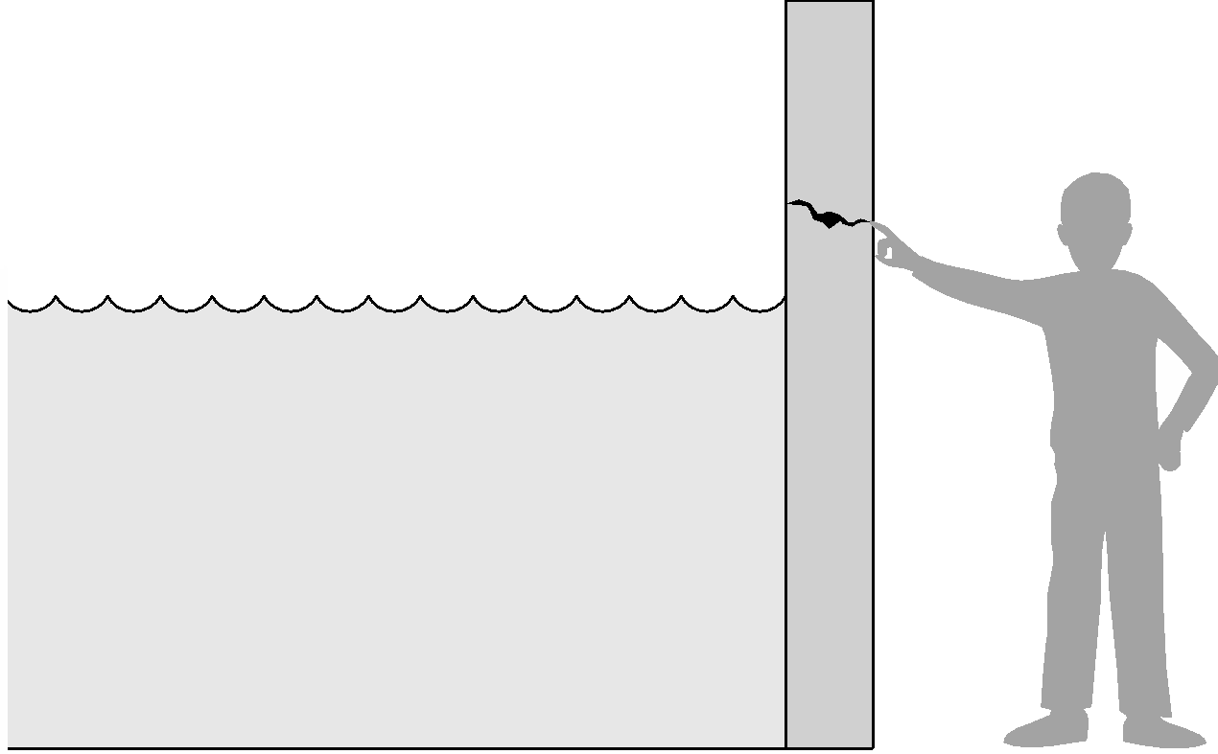
Threat and Vulnerability
Relationship among threats, controls, and vulnerabilities:
A threat is blocked by control of a vulnerability.
To devise controls, we must know as much about threats as possible.
The fact that the violation might occur means that the actions that might cause it should be guarded against.
Notes:
The water is the threat, the crack the vulnerability, and the finger the control (for now).

Slide 11
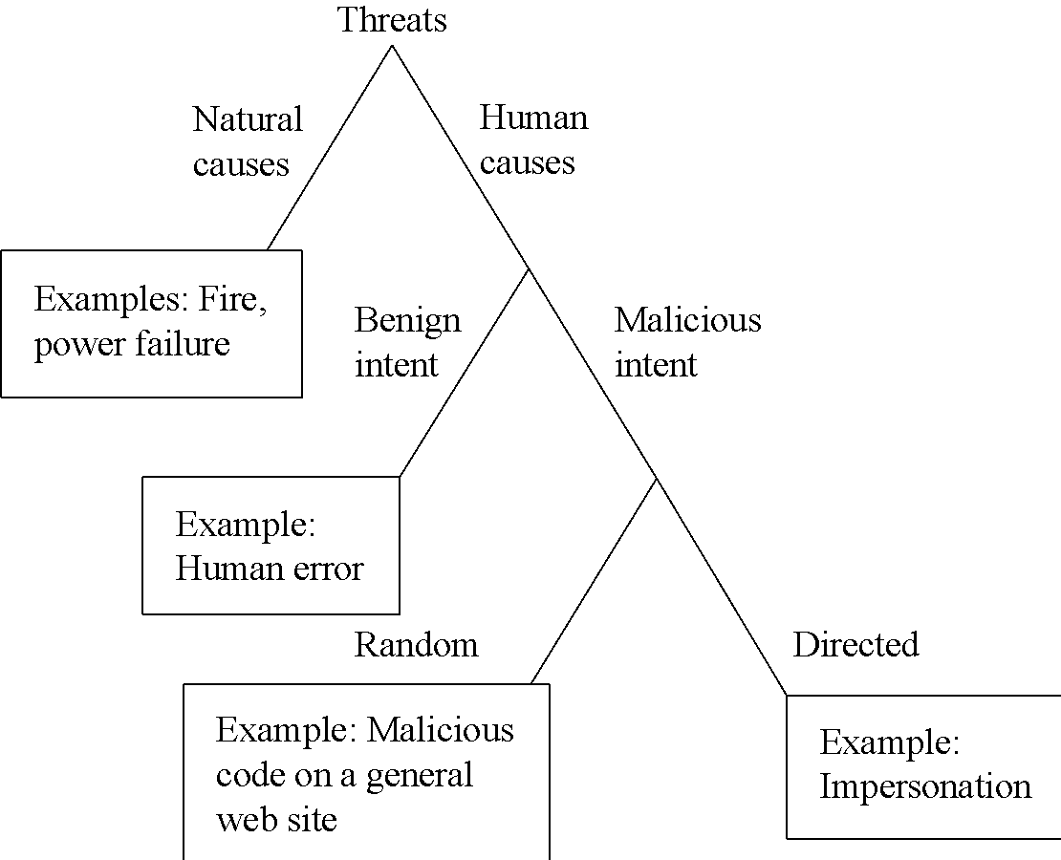
Types of Threats
Notes:
This diagram shows threats categorized according to whether they are human-caused, malicious, or directed. These characteristics will affect security planning in important ways later.

Slide 12
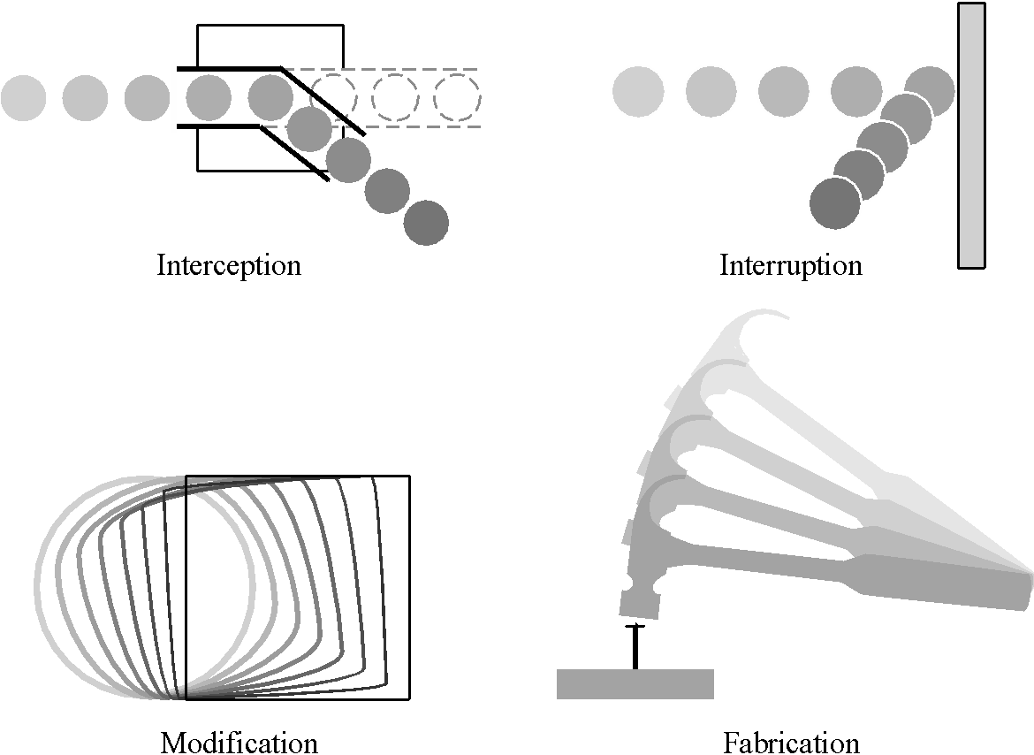
Types of Harm
Notes:
These are the primary types of harm against system data and functions. Understanding these possibilities is important to considering threat and risk.

Slide 13
Harm
In an interception means that some unauthorized party has gained access to an asset.
In an interruption, an asset of the system becomes lost, unavailable, or unusable.
If an unauthorized party not only accesses but tampers (forges) with an asset, the threat is a modification.
Finally, an unauthorized party might create a fabrication of counterfeit objects on a computing system.

Slide 14
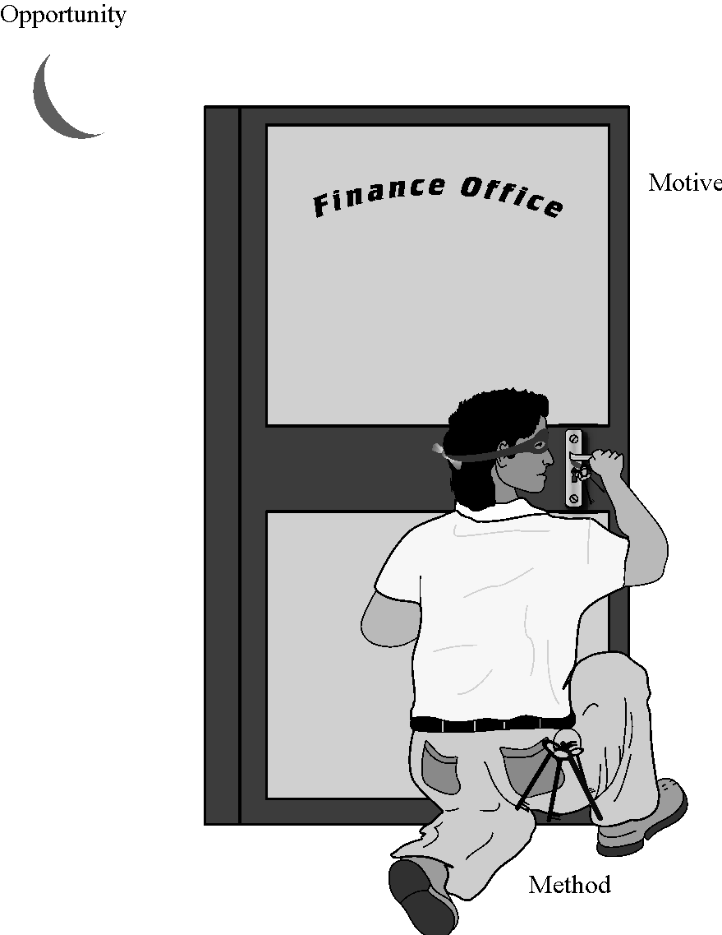
Method—Opportunity—Motive (MOM)
Notes:
Understanding method, motive, and opportunity can be a good way to think about potential threats. Reducing any of those dimensions can lower the risk to the system.

Slide 15
Method, Opportunity, and Motive
A malicious attacker must have three things (MOM):
method: the skills, knowledge, tools, and other things with which to be able to pull off the attack
Knowledge of systems are widely available
opportunity: the time and access to accomplish the attack
Systems available to the public are accessible to them
motive: a reason to want to perform this attack against this system

Slide 16
Security Goals
When we talk about computer security, we mean that we are addressing three important aspects of any computer-related system: confidentiality, integrity, & availability (CIA)
Confidentiality ensures that computer-related assets are accessed only by authorized parties.
i.e. reading, viewing, printing, or even knowing their existence
Secrecy or privacy
Integrity means that assets can be modified only by authorized parties or only in authorized ways.
i.e. writing, changing, deleting, creating
Availability means that assets are accessible to authorized parties at appropriate times.
i.e. often, availability is known by its opposite, denial of service.

Slide 17
Relationship between Confidentiality Integrity and Availability
In fact, these three characteristics can be independent, can overlap, and can even be mutually exclusive.
Confidentiality
Integrity
Secure
Availability

Slide 18
C-I-A Triad
Confidentiality
Integrity
Availability
Sometimes two other desirable characteristics:
Authentication
the process or action of proving or something to be true, genuine, or valid showing
Nonrepudiation
is the assurance that someone cannot deny something.
i.e. nonrepudiation refers to the ability to ensure that a party to a contract or a communication cannot deny the authenticity of their signature on a document or the sending of a message that they originated

Slide 19
Goals of Security
Prevention
Prevent attackers from violating security policy
Detection
Detect attackers’ violation of security policy
Recovery
Stop attack, assess and repair damage
Continue to function correctly even if attack succeeds

Slide 20
Controls Available
Encryption
We take data in their normal, unscrambled state, called:
cleartext or plaintext, and transform them so that they are unintelligible to the outside observer; the transformed data are called enciphered text or ciphertext.
Encryption clearly addresses the need for confidentiality of data.
Additionally, it can be used to ensure integrity;
data that cannot be read generally cannot easily be changed in a meaningful manner.

Slide 21
Controls Available
Encryption does not solve all computer security problems, and other tools must complement its use.
if encryption is not used properly, it may have no effect on security or could even degrade the performance of the entire system.
Weak encryption can actually be worse than no encryption at all,
because it gives users an unwarranted sense of protection.
Therefore, we must understand those situations in which encryption is most useful as well as ways to use it effectively.

Slide 22
Controls Available
Software/Program Controls
Programs must be secure enough to prevent outside attack
They must also be developed and maintained so that we can be confident of the programs' dependability.
Program controls include the following:
Internal program controls: parts of the program that enforce security restrictions,
i.e. access limitations in a database management program
Operating system and network system controls: limitations enforced by the operating system or network to protect each user from all other users
i.e. run as administrator in windows
Independent control programs: application programs,
i.e. password checkers, intrusion detection utilities, or virus scanners, that protect against certain types of vulnerabilities

Slide 23
Controls Available
Development controls:
quality standards under which a program is designed, coded (implementation), tested, and maintained to prevent software faults from becoming exploitable vulnerabilities
i.e. Penetration testing (pen testing or ethical hacking), is the practice of testing a computer system, network or web application to find security vulnerabilities that an attacker could exploit.
Software controls frequently affect users directly?
i.e. when the user is interrupted and asked for a password before being given access to a program or data.
Because they influence the usability of the system, software controls must be carefully designed.
Ease of use and capabilities are often competing goals in the design of a collection of software controls.

Slide 24
Controls Available
Hardware Controls
Numerous hardware devices have been created to assist in providing computer security. These devices include a variety of means, such as
hardware or smart card implementations of encryption
locks or cables limiting access or deterring theft
devices to verify users' identities
firewalls
intrusion detection systems
circuit boards that control access to storage media

Slide 25
Controls Available
Policies and Procedures
Sometimes, we can rely on agreed-on procedures or policies among users rather than enforcing security through hardware or software means
i.e. frequent changes of passwords
We must not forget the value of community standards and expectations when we consider how to enforce security.
Physical Controls
i.e. locks on doors,
guards at entry points,
backup copies of important software and data, and
physical site planning that reduces the risk of natural disasters.

Slide 26
Principle of Weakest Link
Security can be no stronger than its weakest link !!!
Whether it is the power supply that powers the firewall or the operating system under the security application or the human who plans, implements, and administers controls, a failure of any control can lead to a security failure.

Slide 27
Summary
Vulnerabilities are weaknesses in a system;
threats exploit those weaknesses;
controls protect those weaknesses from exploitation
Confidentiality, integrity, and availability are the three basic security primitives
Different attackers pose different kinds of threats based on their capabilities and motivations
Different controls address different threats; controls come in many flavors and can exist at various points in the system

